Slide 1

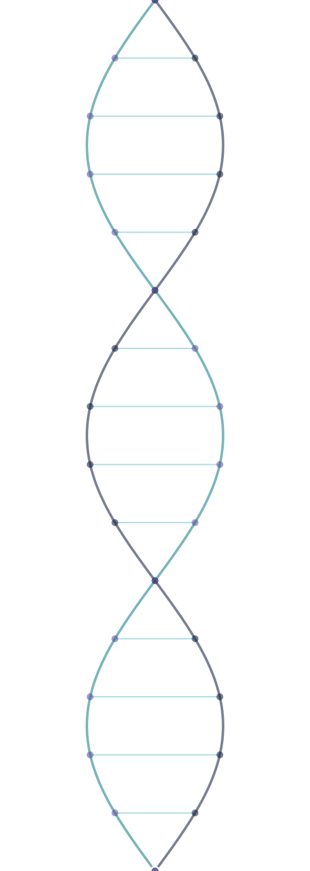
V YEAR IDP-B.TECH DISSERTATION
EXPLAINABLE AI FOR MUSCULAR DYSTROPHY SUBTYPE CLASSIFICATION
DEPARTMENT OF COMPUTER SCIENCE AND ENGINEERING
Jawaharlal Nehru Technological University Hyderabad
UNIVERSITY COLLEGE OF ENGINEERING, SCIENCE AND TECHNOLOGY, JNTUH
PRESENTED BY
GUIDE
D. Vaishnavi
Dr. B. Kranthi Kiran
Roll No: 22011P0552
Professor & Coordinator – SC / ST Cell ,JNTUH

Slide 2
Table of Contents
A quick map of the sections covered in this presentation
01
Abstract
07
Methodology
02
Introduction
08
Algorithms Used
03
Existing Work & Base Papers
09
Model Evaluation & Metrics
04
Problem Statement
10
Expected Outcomes & Conclusion
05
Dataset Overview
11
References
06
System Architecture
2

Slide 3




Abstract
A snapshot of the problem, data, method, and explainability behind the project
PROBLEM
DATA
Muscular-dystrophy subtypes show overlapping clinical and molecular features, making subtype classification difficult.
NCBI GEO GSE3307 skeletal-muscle transcriptomic dataset, integrating verified GPL96 and GPL97 measurements.
METHOD
EXPLAINABILITY
Elastic-Net feature selection, followed by comparative classification: Elastic-Net • XGBoost • CatBoost • LightGBM • TabNet.
Predictions interpreted using TreeSHAP, DiCE counterfactuals, and biological pathway mapping via KEGG and Reactome.
Transcriptomic
Data
Machine
Learning
Explainability
Subtype
Prediction
Biological
Interpretation
3

Slide 4




Introduction
Why muscular-dystrophy subtypes are hard to tell apart, and how explainable AI can help
01
02
03
Muscular Dystrophy
Gene-Expression Data
AI + Explainability
Inherited disorders that gradually damage muscles
Genes behave differently in each disease
AI learns patterns from gene-expression data
Different subtypes often look similar
These patterns are called transcriptomic data
Explainable AI shows which genes mattered
Hard to tell subtypes apart
May help distinguish subtypes
Makes the prediction easier to understand
“Use muscle gene-expression patterns with AI to classify muscular-dystrophy subtypes — and explain why the model made its prediction.”
GOAL
Predict the subtype and understand the important gene patterns behind the prediction.
4

Slide 5
Existing Work & Base Papers
Prior work this project builds on, and what we extend
PAPER 1
PAPER 2
PAPER 3
Bakay et al. (2006)
Verdú-Díaz et al. (2025)
Ayyappadas et al. (2026)
Established the transcriptomic foundation GSE3307 by studying gene-expression patterns associated with muscular dystrophies.
Myo-Guide: a machine-learning web app for neuromuscular disease diagnosis using MRI.
An XGBoost model with SHAP explainability for muscular-dystrophy classification on synthetic clinical data.
WHAT WE TAKE
WHAT WE TAKE
WHAT WE TAKE
• Skeletal-muscle transcriptomic profiles
• ML diagnostic-support concept
• XGBoost classification
• Disease-group structure
• SHAP-based interpretation
• SHAP explanations
• Biological basis
• Clinician-oriented visualization
OUR EXTENSION
OUR EXTENSION
OUR EXTENSION
• Patient-level subtype classification
• Transcriptomic rather than MRI input
• Real GSE3307 transcriptomic data
• Cross-platform fusion
• Pathway validation with DiCE
• Elastic Net + multi-model comparison
• Explainable ML
• FastAPI + React + Plotly prototype
• KEGG/Reactome + patient-level explanation
5

Slide 6
Problem Statement
Why overlapping subtypes and high-dimensional data make classification challenging
Develop a machine-learning framework to classify selected muscular-dystrophy subtypes using skeletal-muscle transcriptomic data from the NCBI GEO GSE3307 dataset.
4

Slide 7
Dataset Overview
NCBI GEO GSE3307 • Skeletal-muscle transcriptomic dataset
SOURCE
NCBI Gene Expression Omnibus
GSE3307
Human skeletal-muscle expression profiling
242
121
2
6
Expression arrays
GPL96–GPL97 pairs
Platforms
Target classes
Verified GEO records
Verified paired samples
GPL96 + GPL97
Healthy + 5 disease groups
PLATFORMS
DATA STRUCTURE
GPL96 • Affymetrix HG-U133A
242 arrays
Gene / probe features
ROWS
COLUMNS
GPL97 • Affymetrix HG-U133B
TARGET CLASSES
Healthy
DMD
BMD
LGMD2A
LGMD2B
LGMD2I
7

Slide 8
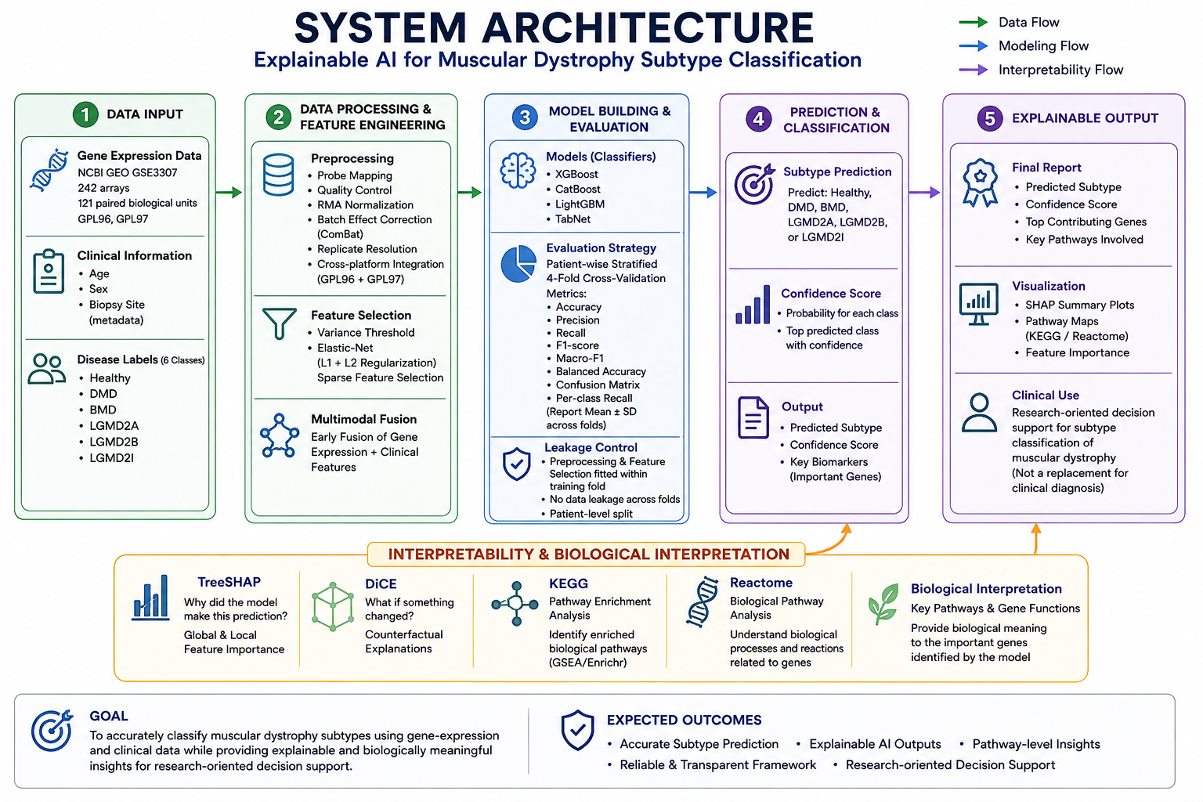

Slide 9
Methodology
Step-by-step approach used to build and evaluate the proposed framework
1.
Data Collection & Verification
Collect GSE3307 skeletal-muscle expression data and verify disease labels, GPL96/GPL97 platforms, sample IDs, and biological-unit relationships.
2.
Preprocessing & Cross-Platform Fusion
Map probes to genes, perform quality control and normalization, resolve replicates, and integrate compatible GPL96 and GPL97 measurements.
3.
Feature Selection & Model Development
Use Elastic-Net to select informative genes, then train and compare XGBoost, CatBoost, LightGBM, and TabNet classifiers.
4.
Validation & Explainability
Evaluate using grouped/patient-wise stratified 4-fold cross-validation; explain predictions with TreeSHAP and generate DiCE counterfactuals.
5.
Biological Interpretation & Output
Assess important genes with KEGG/Reactome pathway enrichment and present subtype predictions, gene evidence, and explanations through the research dashboard.
KEY CONTROL
Preprocessing and feature selection are fitted within the training fold before evaluating the held-out fold.
11

Slide 10
Algorithms Used
What each method does and how it contributes to the proposed workflow
01
Elastic-Net
02
XGBoost
Selects a sparse set of informative genes.
Classifies disease subtypes using decision trees.
Combines L1 + L2 regularization to reduce irrelevant features and handle correlated genes.
Builds trees sequentially, with each new tree correcting previous errors.
03
CatBoost
04
LightGBM + TabNet
Comparative gradient-boosting classifier.
Two additional models for benchmarking.
Builds an ensemble of decision trees to learn nonlinear patterns in the data.
LightGBM uses efficient gradient boosting; TabNet uses attention to focus on useful tabular features.
EXPLAINABILITY METHODS
Why did the model make this prediction? Measures each gene's contribution to a tree-model prediction.
What-if explanation? Generates alternative input configurations that could change the model's prediction.
TreeSHAP
DiCE
BIOLOGICAL CONTEXT
KEGG + Reactome → map important genes to biological pathways for interpretation.
12

Slide 11
Model Evaluation & Metrics
How the models will be tested and on what basis their performance will be compared
EVALUATION BASIS
Grouped / patient-wise stratified 4-fold cross-validation
01
Accuracy
02
Precision
03
Recall / Sensitivity
Overall proportion of predictions that are correct.
When the model predicts a subtype, how often is it correct?
Of the true samples in a subtype, how many are identified?
Correct predictions / Total predictions
TP / (TP + FP)
TP / (TP + FN)
04
F1-Score
05
Macro-F1
06
Balanced Accuracy
Balances precision and recall.
Averages F1 equally across all disease classes.
Averages recall across classes; useful for imbalanced data.
2 × Precision × Recall / (Precision + Recall)
(1 / K) × Σ F1ᵢ
(1 / K) × Σ Recallᵢ
ALSO REPORT
Confusion Matrix • Per-class Recall • Mean ± SD across folds
13

Slide 12
Expected Outcomes & Conclusion
The proposed framework, from transcriptomic input to interpretable research output
GSE3307
Fusion
Elastic-Net
ML Models
XAI
Biology
Data
GPL96 + GPL97
Gene selection
Classification
SHAP + DiCE
KEGG + Reactome
EXPECTED OUTCOMES
Verified data representation
Comparative model evaluation
Harmonized GSE3307 transcriptomic data at the biological-unit level.
Benchmark multiple classifiers using grouped, leakage-aware validation.
Explainable predictions
Biological interpretation
Identify influential genes with TreeSHAP and generate DiCE counterfactuals.
Relate important genes to pathways through KEGG and Reactome.
CONCLUSION
The framework combines transcriptomic fusion, machine learning, explainability, and biological validation to support transparent subtype classification.
Research-oriented decision support — not a replacement for established clinical diagnosis.
14

Slide 13
References
Selected references supporting the dataset, machine learning, explainability and biological validation
01
Bakay et al. (2006)
05
Frías et al. (2025)
Nuclear envelope dystrophies show a transcriptional fingerprint suggesting disruption of Rb–MyoD pathways in muscle regeneration. Brain, 129(4), 996–1013. DOI: 10.1093/brain/awl023.
The artificial intelligence challenge in rare disease diagnosis: A case study on collagen VI muscular dystrophy. Computers in Biology and Medicine.
02
Hoffman (2005)
06
Lundberg & Lee (2017)
GSE3307: Comparative profiling in 13 muscle disease groups. Gene Expression Omnibus (GEO).
A unified approach to interpreting model predictions. Advances in Neural Information Processing Systems, 30.
03
Verdú-Díaz et al. (2025)
07
Mothilal et al. (2020)
Myo-Guide: A machine learning-based web application for neuromuscular disease diagnosis with MRI. JCSM, 16(3), e13815. DOI: 10.1002/jcsm.13815.
Explaining machine learning classifiers through diverse counterfactual explanations. FAccT 2020, 607–617. DOI: 10.1145/3351095.3372850.
04
Ayyappadas & Madathil et al. (2026)
08
Kanehisa et al. (2017)
An XGBoost-based model with SHAP explainability for muscular dystrophy classification using synthetic clinical data. IJSRTM.
KEGG: New perspectives on genomes, pathways, diseases and drugs. Nucleic Acids Research, 45(D1), D353–D361. DOI: 10.1093/nar/gkw1092.
15

Slide 14


